Slide 1
Autonomous Mobile Manipulator
Project Execution Plan and IP Landscape presentation

Slide 2
Project description and objectives
Research Question
Research Objectives

Slide 3
Project description and objectives
Some example requirements
Hardware
Software

Slide 4
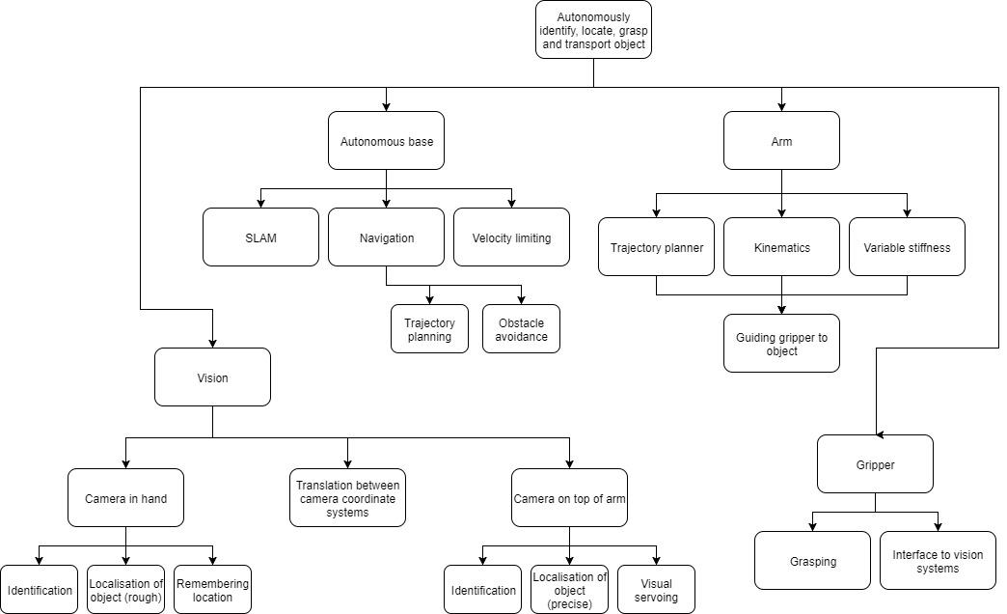
Systems Breakdown

Slide 5
Design Process
Flowchart
Testing examples

Slide 6
Project Management
Philosophy
Roles
Responsibilities
 | Project manager | Electrical manager | Mechanical manager | Software manager | Systems architect | Financial manager
Tom | X | X |  |  | X
Daniel | X |  | X | X |  | X

Slide 7
Risk Management

Slide 8
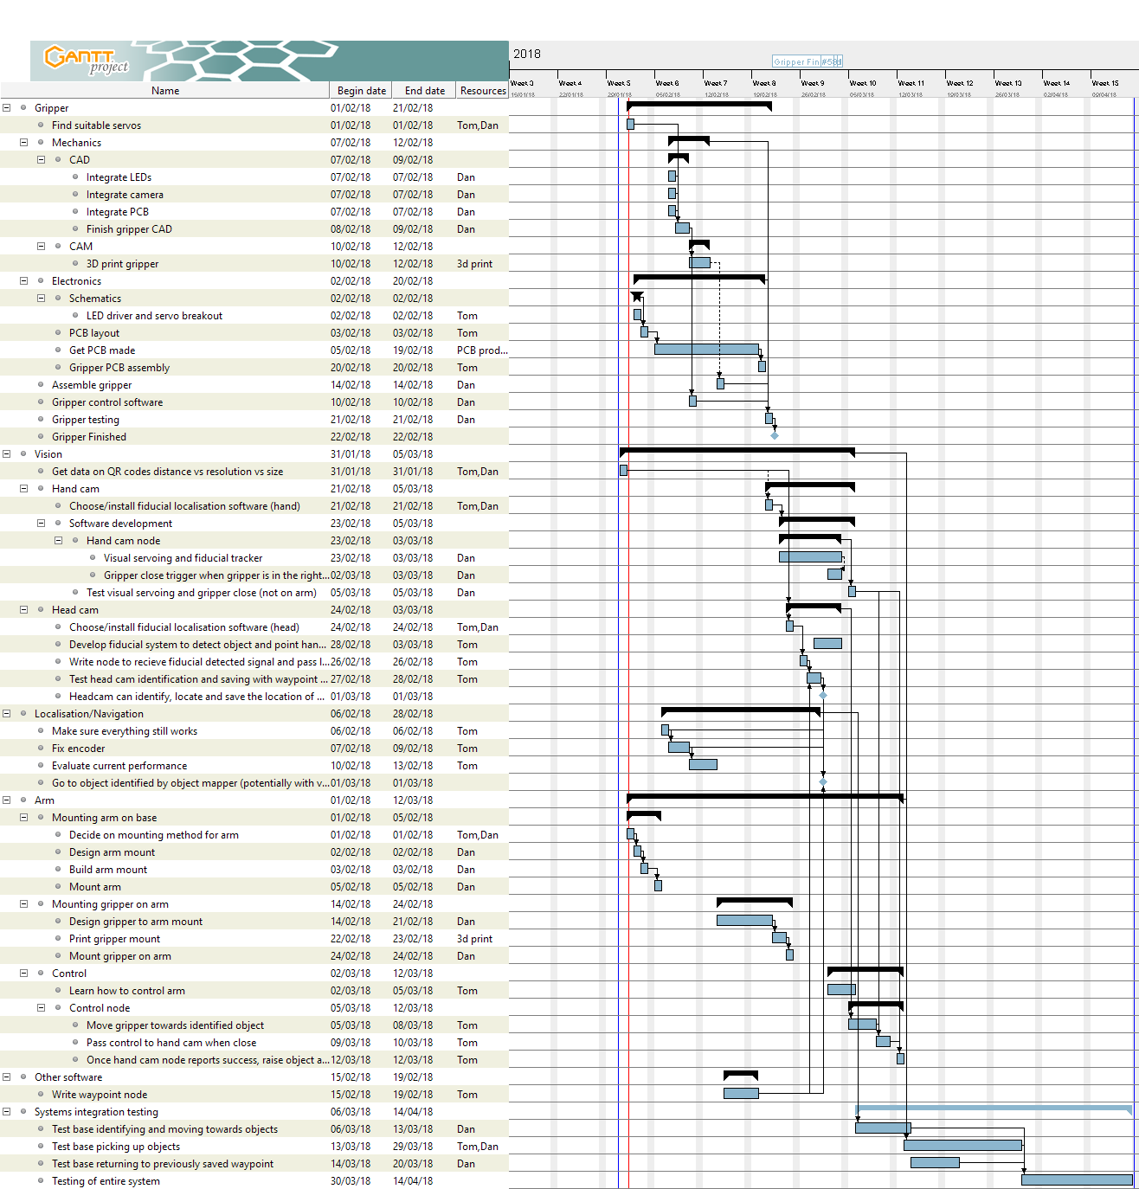
Time plan

Slide 9
IP Landscape
Generalness regarding robotic systems:
All SLAM robots
Aquire, process, visualise
General Gripper

